Slide 1

Code 102: Intro to Software Development
Class 02

Slide 2
Agenda
Review of previous class
Share your learning
Developer Tools
Text Editor
Terminal
Discussion Exercise
Installfest!
Operating Systems
Lab: Install and Configure
Notes:
Here’s our plan for class today

Slide 3
Agenda
Review of previous class
Share your learning
Developer Tools
Text Editor
Terminal
Discussion Exercise
Installfest!
Operating Systems
Lab: Install and Configure
Notes:
You are here.

Slide 4
<review>
What did you learn?
Notes:
There are 4 skills in language learning: Hearing, speaking, reading, writing (and we generally develop them in that order).
These review sessions are your chance to SPEAK with this new language. Practice using the right words. Let these foreign sounds emanate from YOUR mouth. The names of these esoteric characters matter, and using the wrong one will make a difference to the computer.
Go around the room. Each student can share a thing learned, or a sentence from their Learning Journal. Help them use the right words. Document the vocab as necessary on the whiteboard.
Ask specifically for what was learned by reading about other student’s learning.

Slide 5
Agenda
Review of previous class
Share your learning
Developer Tools
Text Editor
Terminal
Discussion Exercise
Installfest!
Operating Systems
Lab: Install and Configure
Notes:
You are here.

Slide 6
Power Tools
“I think one of the things that really separates us from the high primates is that we’re tool builders. I read a study that measured the efficiency of locomotion for various species on the planet. The condor used the least energy to move a kilometer. Humans came in with a rather unimpressive showing, about a third of the way down the list. So, that didn’t look so good. But, then somebody at Scientific American had the insight to test the efficiency of locomotion for a man on a bicycle. And a human on a bicycle blew the condor away, completely off the top of the charts.
“And that’s what a computer is to me. What a computer is to me is it’s the most remarkable tool that we’ve ever come up with, and it’s the equivalent of a bicycle for our minds.”
—Steve Jobs, 1990
More: https://www.brainpickings.org/2011/12/21/steve-jobs-bicycle-for-the-mind-1990/
Notes:
To introduce this section, here’s a quote from Steve Jobs… <READ IT OR HAVE A STUDENT READ IT>

Slide 7
Text Editors
...There are many… Can you name some?
Word Processors
Microsoft Word
Google Docs
Apple Pages
WordPerfect?
...and many more
Code Editors
GitHub’s Atom
Microsoft’s VS Code, Visual Studio
NotePad++
Vim, Emacs, Nano, TextMate
...and many more
Notes:
Ask students what they can name…

Slide 8
The Terminal
AKA: The Command Line Interface (cli)
File Explorer Tasks:
Find files
Change directories
Move and copy files
Open files
Make new files / folders
Terminal Tasks:
Find files, or file content
Change directories
Move and copy files
Open files
Make new files and folders
...and much much more
Notes:
Ask students: What are things they do in file explorer?
Find files
Change directories
Move / copy files
Open files
Make new files / folders
You can do all that and more from the Terminal. Learn to use it equivalently, and then you’ll layer on even more power.

Slide 9
<demo>
<exercise>
Can you see why it matters?
Notes:
Show the tools in action:
Write some HTML in VS Code, and ask for observations.
Say: You may not write code this fast yet, but just focus on what the text editor is doing to help me.
Create: Write up an HTML file from scratch.
WHY is this better than Microsoft Word?
Move around a bit in the terminal between / within code projects.
Show the same actions in the GUI
WHY is the Terminal better than File Explorer/Finder?
Hands stay on they keyboard
Actions can be described precisely (simply “cd xyz”, rather than “Look through the list for a folder named xyz, and doulbe-click on it”)
Actions are can be written down, chained, scripted…
Other commands can be accessed (like git) that are often unavailable in the GUI
See /demo for details.
Then get students going on the DISCUSSION exercise for the day.

Slide 10
Agenda
Review of previous class
Share your learning
Developer Tools
Text Editor
Terminal
Discussion Exercise
Installfest!
Operating Systems
Lab: Install and Configure
Notes:
You are here.

Slide 11
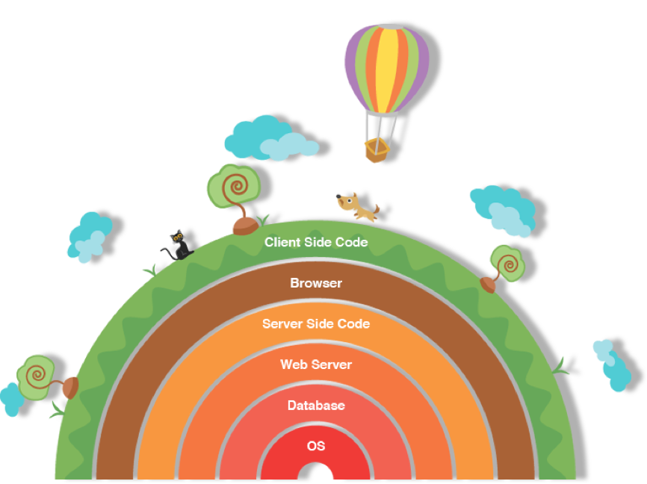
The
Power
of
Abstraction
Ignore
Details
In
Layers
Above
And
Below
Notes:
Abstraction simply means we leave out some irrelevant details.
Each of these layers has a different problem to solve, so different approaches are utilized. Even within each layer, multiple interchangeable options exist. What you use is your “stack”.
At the bottom: YOUR OPERATING SYSTEM
ASK: What is the job of the OS?
Install programs
Control the hardware: HDD, RAM, peripherals, etc
File management
Control which program is getting CPU time
User management
etc

Slide 12
<exercise>
Installfest!
Notes:
Get students going with following the computer setup guide.
Group students up by OS, and have them work through the guide together.

